Slide 1
Gradient Descent
© Dr. Umberto Michelucci - umberto.michelucci@toelt.ai
Dr. Umberto Michelucci
umberto.michelucci@toelt.ai

Slide 2
Optimisers
© Dr. Umberto Michelucci - umberto.michelucci@toelt.ai
Premature optimization is the root of all evil.
― Donald Ervin Knuth, The Art of Computer Programming, Volume 1

Slide 3
Optimiser – a definition
In machine learning, an optimizer is an algorithm or method used to change the attributes of an algorithm (for example a neural network), such as weights, to reduce the loss function.
Optimizers are used to solve optimization problems by minimizing (or maximizing) an objective function.
The choice of the optimizer can significantly influence the speed and quality of the learning process.
© Dr. Umberto Michelucci - umberto.michelucci@toelt.ai

Slide 4
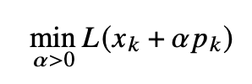
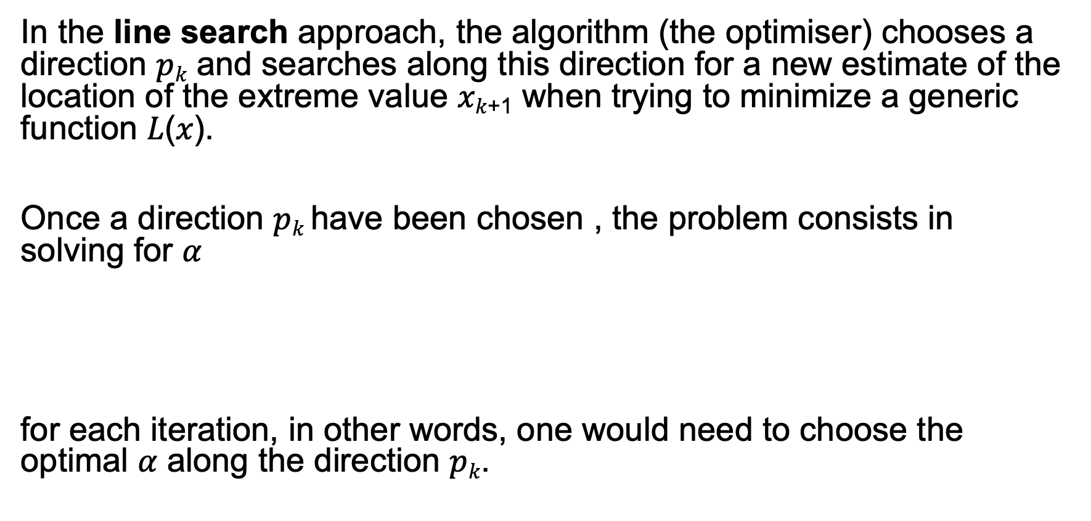
Line Search Algorithms
In the line search approach, the algorithm (the optimiser) chooses a direction 𝑝_{𝑘} and searches along this direction for a new estimate of the location of the extreme value 𝑥_{𝑘+1} when trying to minimize a generic function 𝐿(𝑥).
Once a direction 𝑝_{𝑘} have been chosen , the problem consists in solving for $α$
for each iteration, in other words, one would need to choose the optimal 𝛼 along the direction 𝑝_{𝑘}.
© Dr. Umberto Michelucci - umberto.michelucci@toelt.ai

Slide 5

Line Search Algorithms
In general this cannot be solved exactly.
This approach is used by choosing a fixed 𝛼 (that is called the learning rate). After fixing 𝛼 one uses the formula
© Dr. Umberto Michelucci - umberto.michelucci@toelt.ai
New estimate
Previous estimate

Slide 6
Trust Region Approach Algorithms
In the trust region approach, the information available on 𝐿 is used to build a model function 𝑚_{𝑘} (typically quadratic in nature) that approximates L in a sufficiently small region around 𝑥_{𝑘}. Then this approximation is used to choose a new 𝑥_{𝑘+1}.
We will not discuss this approach. Is not used in machine learning.
© Dr. Umberto Michelucci - umberto.michelucci@toelt.ai

Slide 7
Steepest Descent - a.k.a. gradient descent
© Dr. Umberto Michelucci - umberto.michelucci@toelt.ai
Moving fast is not the same as going somewhere.
-- Robert Anthony

Slide 8
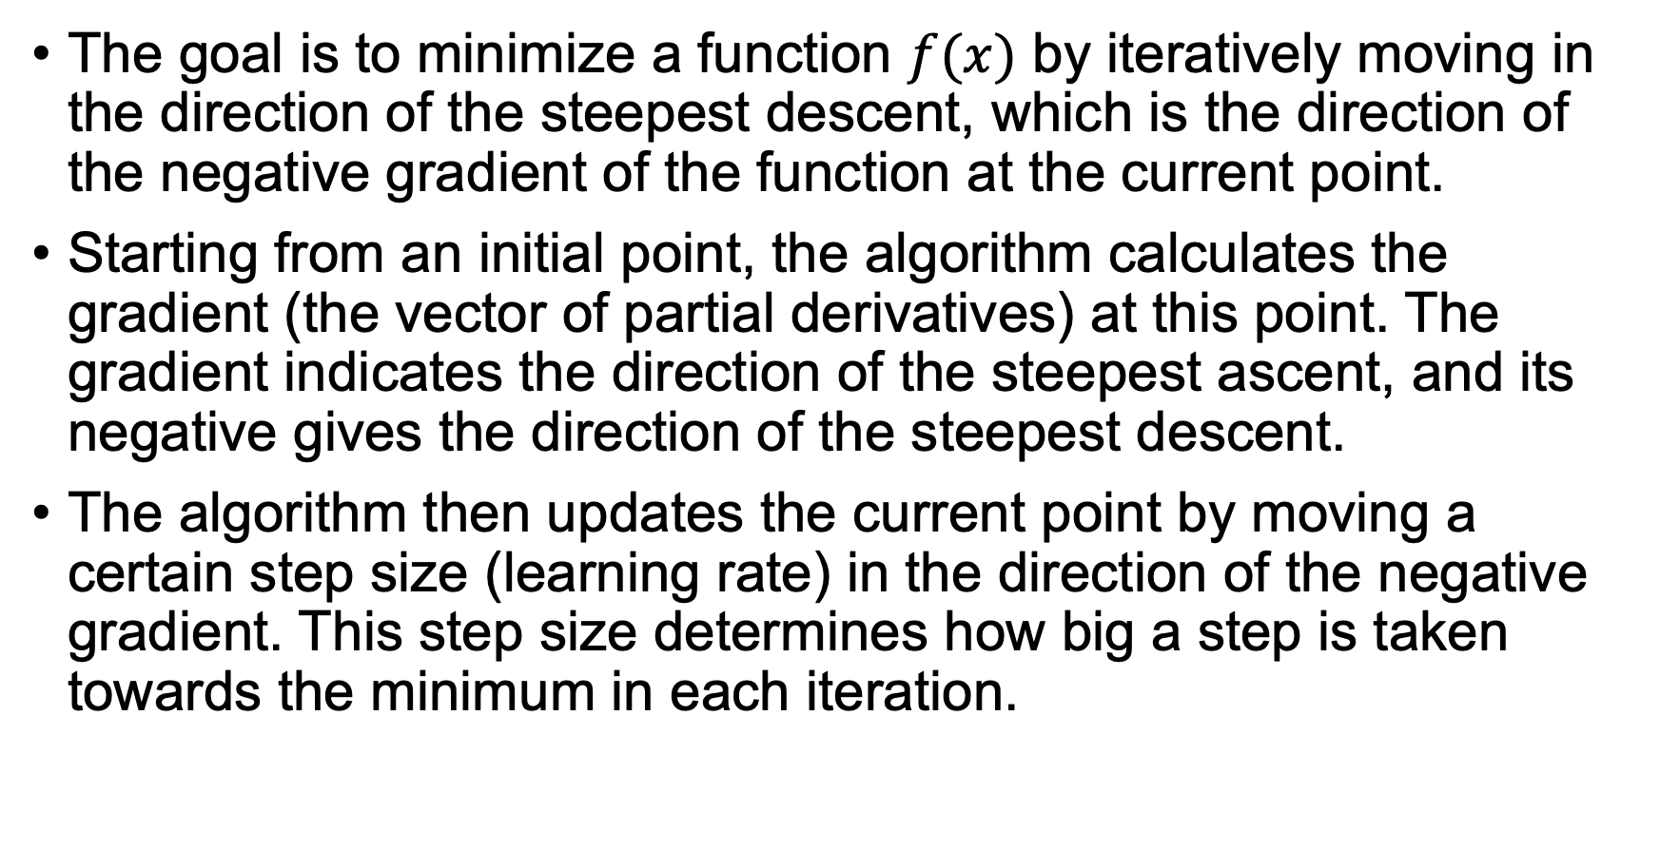
The idea
The goal is to minimize a function $f(x)$ by iteratively moving in the direction of the steepest descent, which is the direction of the negative gradient of the function at the current point.
Starting from an initial point, the algorithm calculates the gradient (the vector of partial derivatives) at this point. The gradient indicates the direction of the steepest ascent, and its negative gives the direction of the steepest descent.
The algorithm then updates the current point by moving a certain step size (learning rate) in the direction of the negative gradient. This step size determines how big a step is taken towards the minimum in each iteration.
© Dr. Umberto Michelucci - umberto.michelucci@toelt.ai

Slide 9
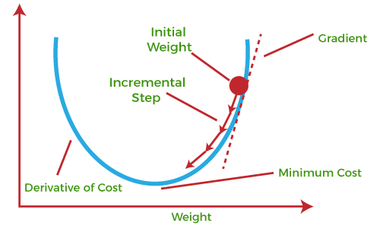
The idea – but graphically
© Dr. Umberto Michelucci - umberto.michelucci@toelt.ai
Image source: https://www.javatpoint.com/gradient-descent-in-machine-learning

Slide 10
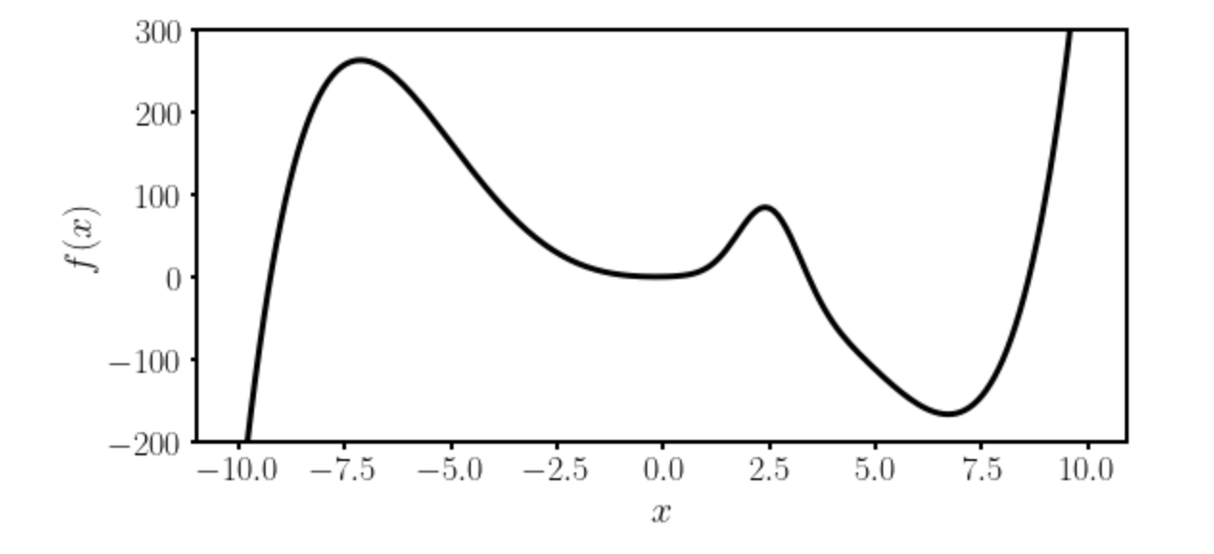
Gradient Descent I
Local minimum
Absolute minimum
© Dr. Umberto Michelucci - umberto.michelucci@toelt.ai
Let’s suppose we want to find the absolute minimum of a given function $f(x)$.

Slide 11
Gradient Descent II
There is no analytical solution to the position of the absolute minimum for a generical algorithm (at least not as in easy cases as linear regression).
Thus numerical methods are required.
© Dr. Umberto Michelucci - umberto.michelucci@toelt.ai

Slide 12


Gradient Descent III
The most used method is called Gradient Descent and uses the following formula (in 1-Dimension)
$$x_{n+1}→x_{n}−γ \frac{df}{dx}(x_{n})$$
Slope of the
function to be
minimized
© Dr. Umberto Michelucci - umberto.michelucci@toelt.ai
New minimum location
approximation
Previous minimum location
approximation
Learning rate
The starting point $x_{0}$ is crucial.
Which one should we choose? Does it make a difference?

Slide 13

Gradient Descent IV
Update slow (slope is near zero)
Very fast update
© Dr. Umberto Michelucci - umberto.michelucci@toelt.ai
Slope of the
function to be
minimized
$$x_{n+1}→x_{n}−γ \frac{df}{dx}(x_{n})$$

Slide 14
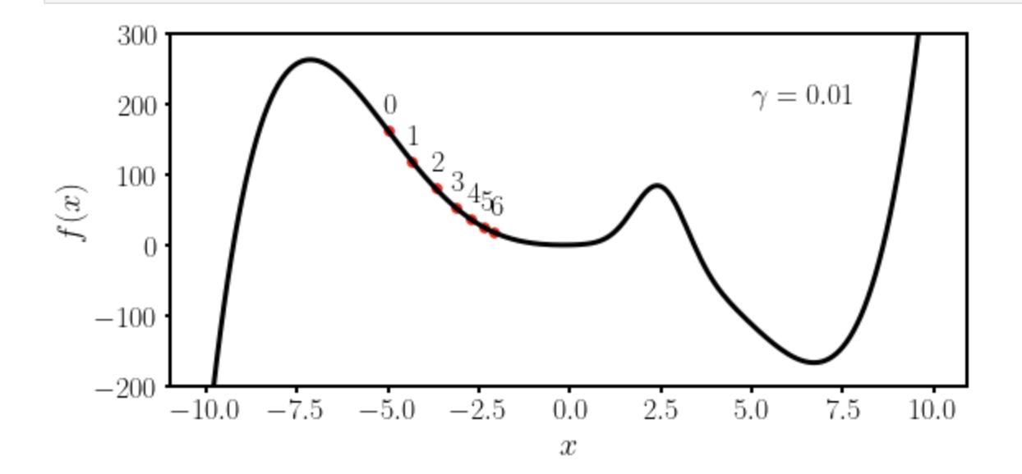
Gradient Descent V
© Dr. Umberto Michelucci - umberto.michelucci@toelt.ai
Let’s suppose we want to find the absolute minimum of a given function $f(x)$.
We choose $x_{0}=−5$ and $γ=0.01$

Slide 15
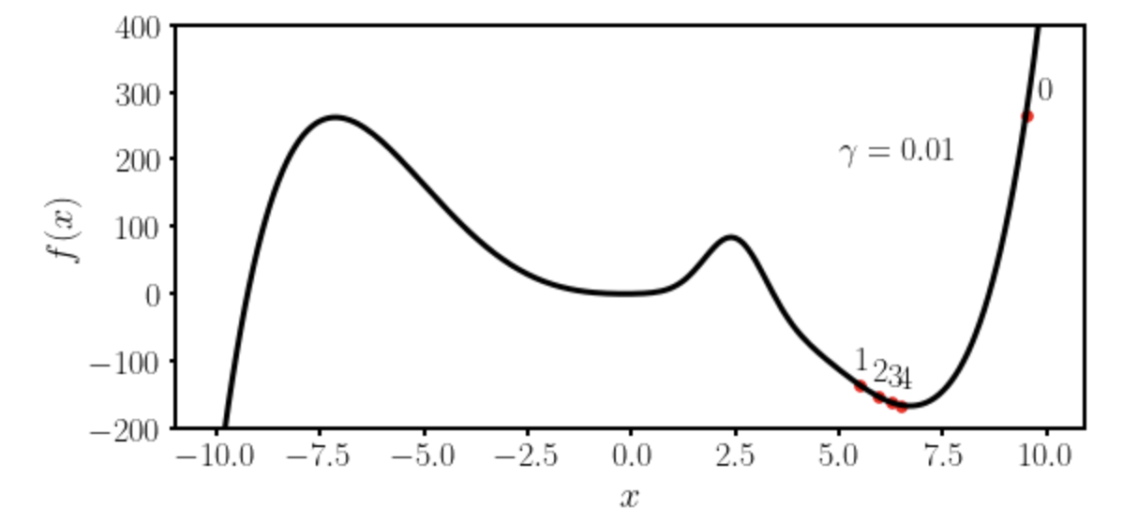
Gradient Descent VI
© Dr. Umberto Michelucci - umberto.michelucci@toelt.ai
Let’s suppose we want to find the absolute minimum of a given function $f(x)$.
We choose $x_{0}=−9.5$ and $γ=0.01$

Slide 16
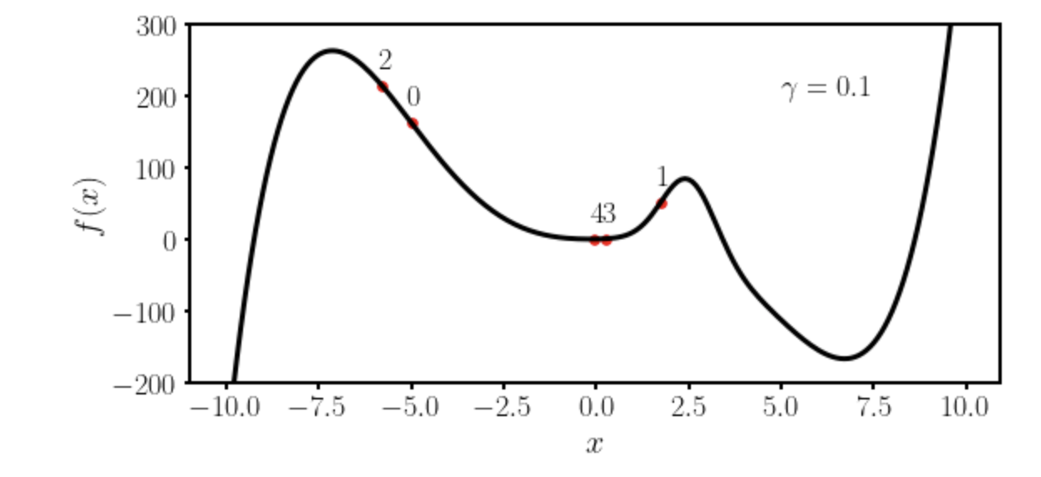
Gradient Descent VII
© Dr. Umberto Michelucci - umberto.michelucci@toelt.ai
Let’s suppose we want to find the absolute minimum of a given function $f(x)$.
We choose $x_{0}=−5$ and $γ=0.1$

Slide 17
Some remarks about gradient descent
To use gradient descent you will need the derivative (or gradient in multiple dimensions) of the function you want to minimize.
→ Gradient descent is not the most efficient way of finding minima. It gets easily stuck in local minima. More advanced optimisers have been developed and are typically used (see Adam).
© Dr. Umberto Michelucci - umberto.michelucci@toelt.ai

Slide 18
Vanishing Gradient Problem
Cause: The issue arises when the gradients of the network's loss function become increasingly small as the backpropagation algorithm progresses through the layers. This phenomenon is particularly pronounced in deep networks with many layers.
Effect on Learning: When the gradients become very small, the updates to the weights in the earlier layers of the network (closer to the input) become negligible. This means that these layers learn very slowly, if at all, impeding the overall training process of the network.
© Dr. Umberto Michelucci - umberto.michelucci@toelt.ai

Slide 19
Small Tip
Slow learning due to the vanishing gradient problem can occur when the input values (typically in neural networks) are too large (more on that will come).
© Dr. Umberto Michelucci - umberto.michelucci@toelt.ai

Slide 20
Gradient Descent – Vanishing Gradient Problem
Update slow (slope is near zero)
Very fast update
© Dr. Umberto Michelucci - umberto.michelucci@toelt.ai
Slope of the
function to be
minimized
$$x_{n+1}→x_{n}−γ \frac{df}{dx}(x_{n})$$

Slide 21
Solutions to the vanishing gradient problem
Various strategies have been developed to mitigate the vanishing gradient problem:
such as using alternative activation functions (e.g., ReLU)
Better weight initialization techniques
Other Optimisers (Adam, RMSProp, etc.)
© Dr. Umberto Michelucci - umberto.michelucci@toelt.ai

Slide 22



Gradient Descent - Example
We want to minimize the function
Gradient Descent Formula
© Dr. Umberto Michelucci - umberto.michelucci@toelt.ai
Fundamental Mathematical Concepts for Machine Learning in Science, Umberto Michelucci, Springer Nature (available in 2024)

Slide 23
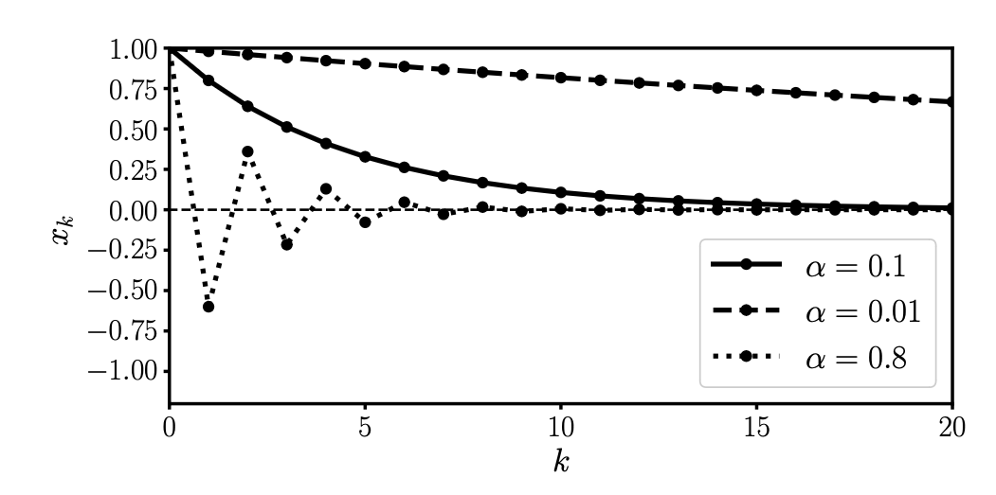
Gradient Descent - Example
© Dr. Umberto Michelucci - umberto.michelucci@toelt.ai
Fundamental Mathematical Concepts for Machine Learning in Science, Umberto Michelucci, Springer Nature (available in 2024)

Slide 24
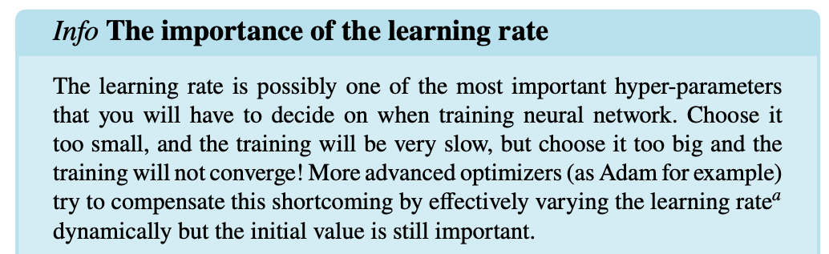
Gradient Descent - Example
© Dr. Umberto Michelucci - umberto.michelucci@toelt.ai
Fundamental Mathematical Concepts for Machine Learning in Science, Umberto Michelucci, Springer Nature (available in 2024)

Slide 25
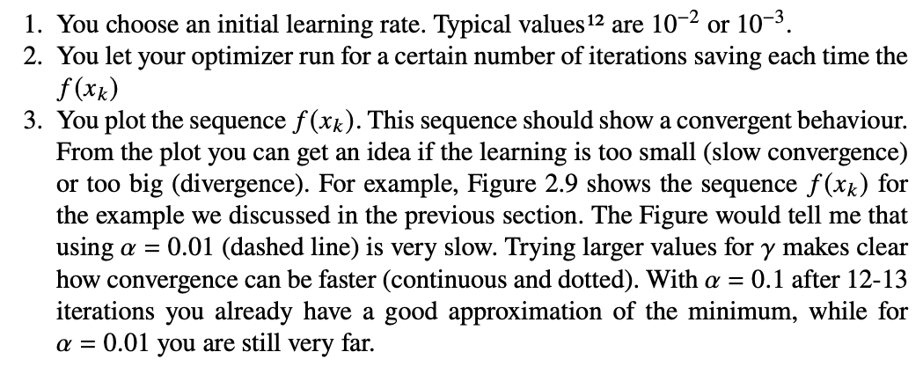
Choosing the right learning rate
© Dr. Umberto Michelucci - umberto.michelucci@toelt.ai
Fundamental Mathematical Concepts for Machine Learning in Science, Umberto Michelucci, Springer Nature (available in 2024)

Slide 26
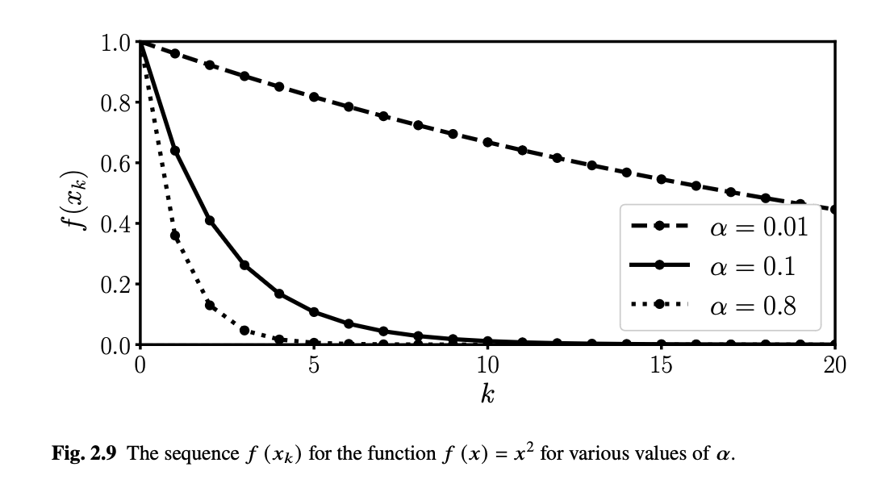
Choosing the right learning rate
© Dr. Umberto Michelucci - umberto.michelucci@toelt.ai
Fundamental Mathematical Concepts for Machine Learning in Science, Umberto Michelucci, Springer Nature (available in 2024)

Slide 27
Variations of Gradient Descent
© Dr. Umberto Michelucci - umberto.michelucci@toelt.ai

Slide 28
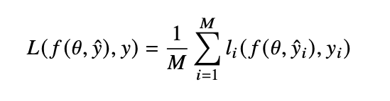
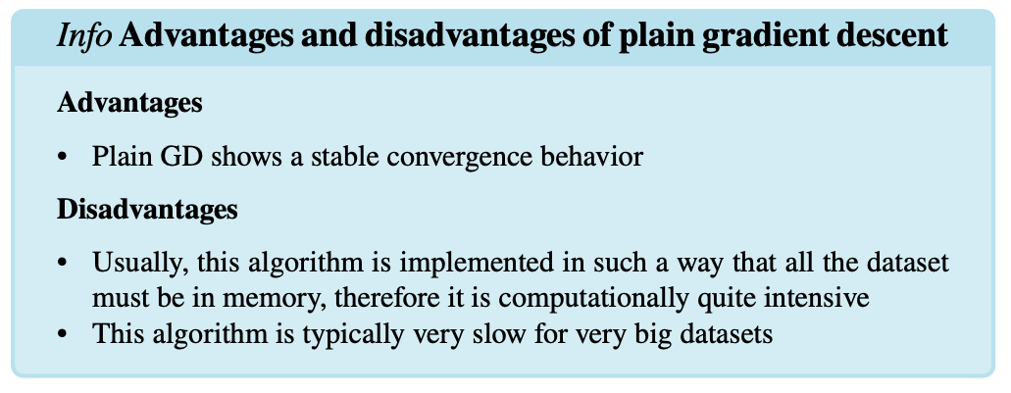
Plain GD
Number of sampes
Loss function
Label
Model Parameters
Model output
© Dr. Umberto Michelucci - umberto.michelucci@toelt.ai
Fundamental Mathematical Concepts for Machine Learning in Science, Umberto Michelucci, Springer Nature (available in 2024)

Slide 29
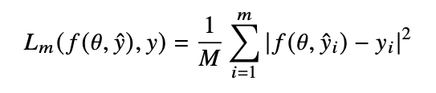
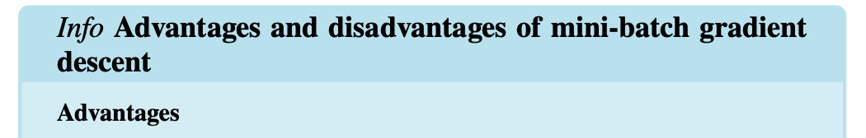
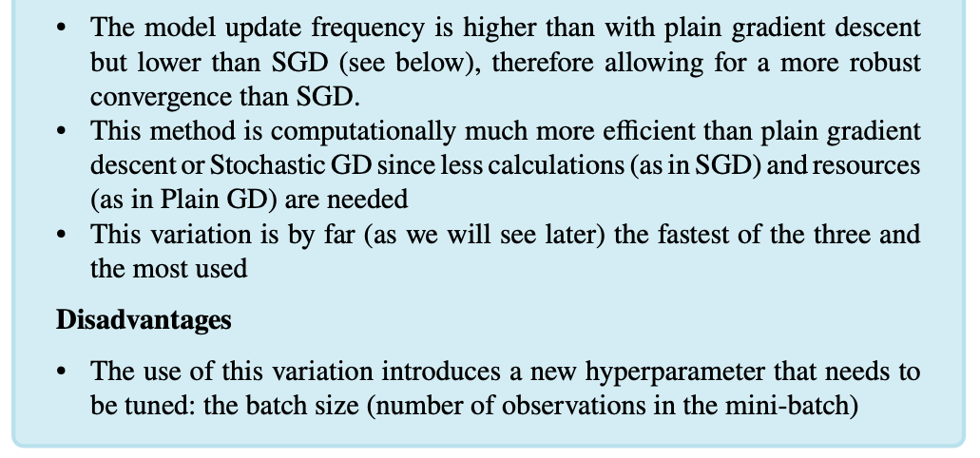

Mini-Batch GD
$$m<M$$
© Dr. Umberto Michelucci - umberto.michelucci@toelt.ai
Fundamental Mathematical Concepts for Machine Learning in Science, Umberto Michelucci, Springer Nature (available in 2024)

Slide 30
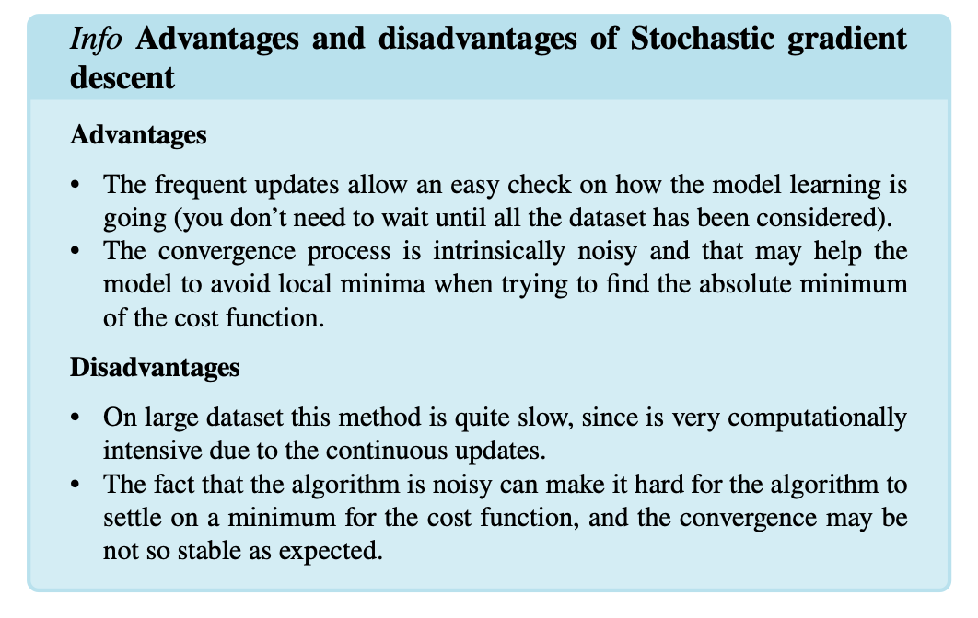

Stochastic GD
$$m=1$$
© Dr. Umberto Michelucci - umberto.michelucci@toelt.ai
Fundamental Mathematical Concepts for Machine Learning in Science, Umberto Michelucci, Springer Nature (available in 2024)

Slide 31
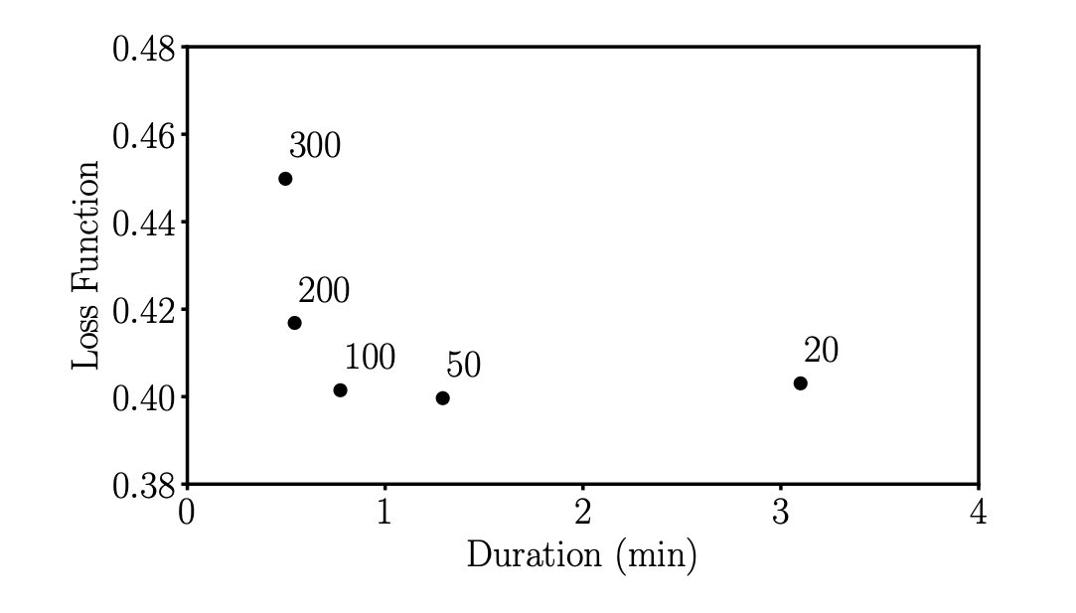
The right mini-batch size
Mini-batch size
© Dr. Umberto Michelucci - umberto.michelucci@toelt.ai
Fundamental Mathematical Concepts for Machine Learning in Science, Umberto Michelucci, Springer Nature (available in 2024)

